Slide 1
New Advocate Orientation

Slide 2
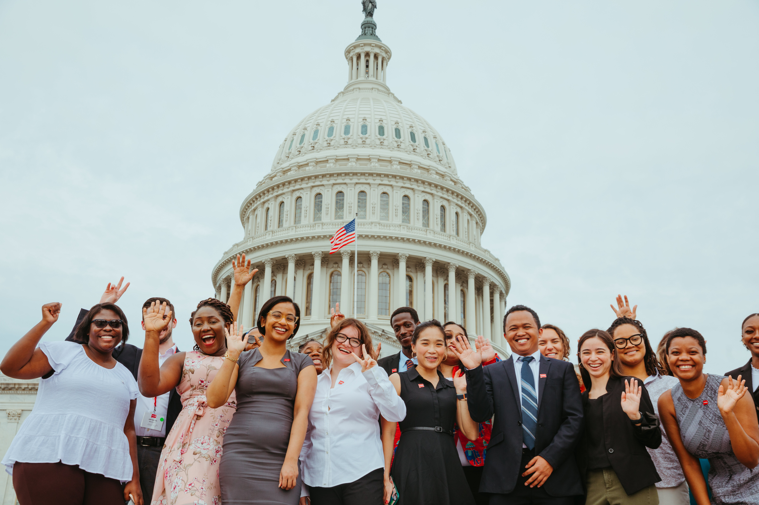
Welcome!
Use the chat to introduce yourself
Name
Pronoun
ONE WORD that describes why you're joining today

Slide 3

Keep in mind…
Stay on mute
Private chat if you have tech issues
Live transcript available
Zoom tip
Want to rename yourself? Right click on your Zoom square and select “rename”

Slide 4
Agenda
About RESULTS
Advocacy model
U.S. & global campaigns
Volunteering overview
Join the movement

Slide 5
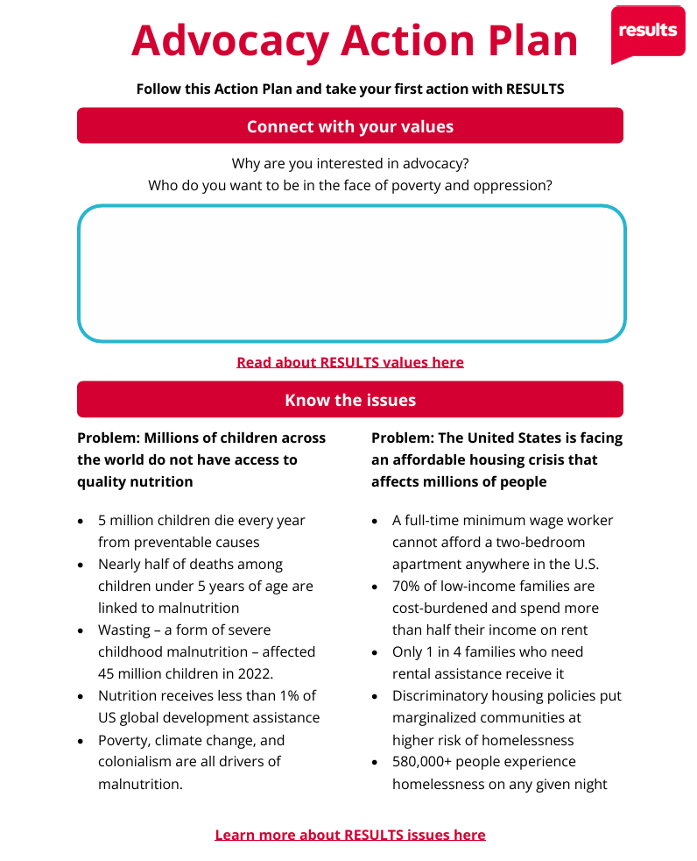
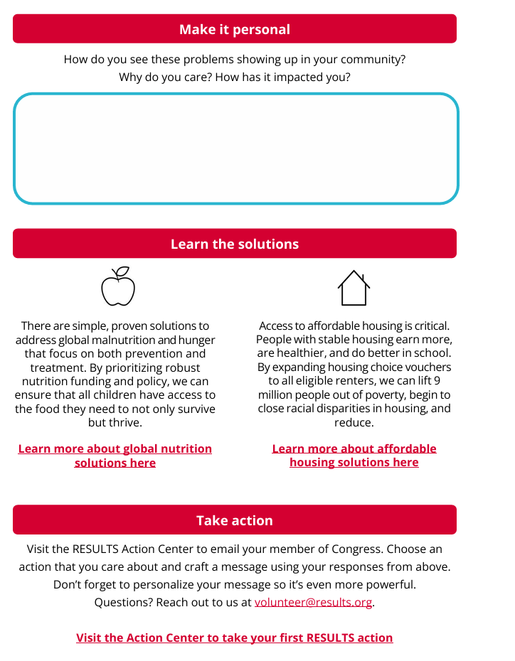

Slide 6
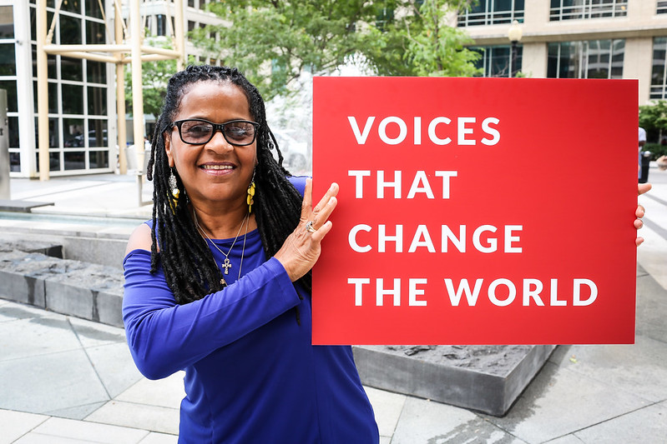
RESULTS is a movement of passionate, committed, everyday people. Together, we use our voices to influence political decisions that will bring an end to poverty.

Slide 7
RESULTS Values
We pledge to create space for all voices, including those of us who are currently experiencing poverty. We will address oppressive behavior in our interactions, families, communities, work, and world.
With unearned privilege comes the responsibility to act so the burden to educate and change doesn’t fall solely on those experiencing oppression. When we miss the mark on our values, we will acknowledge our mistake, seek forgiveness, learn, and work together as a community to pursue equity.
Read more at: results.org/values

Slide 8
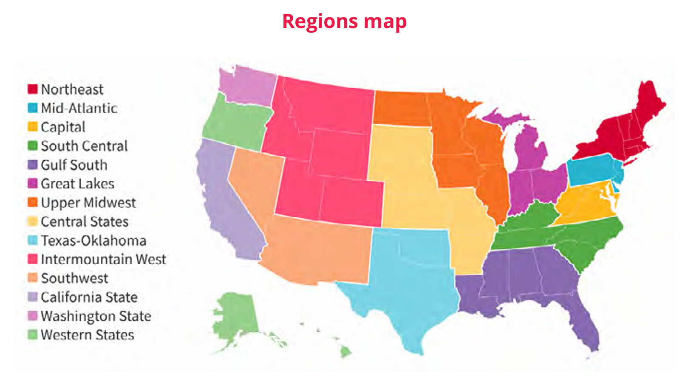
U.S. Grassroots Network
RESULTS Regions
results.org/where-we-are/

Slide 9
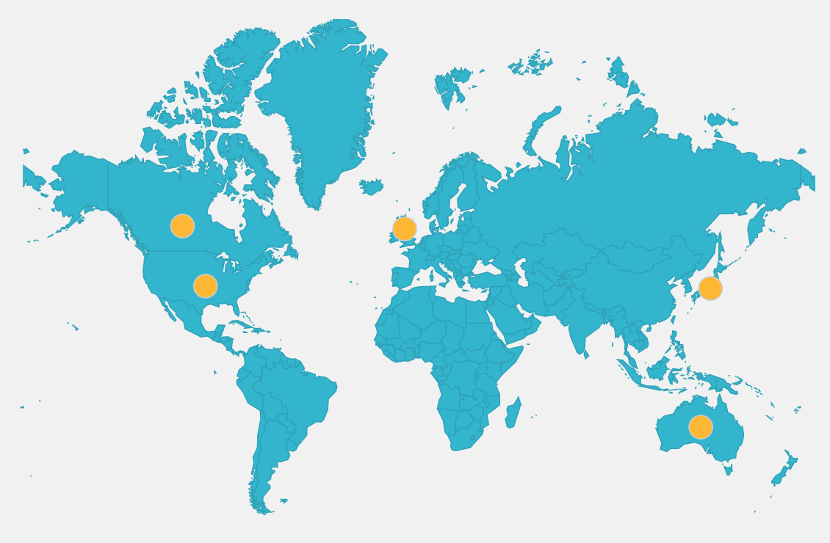
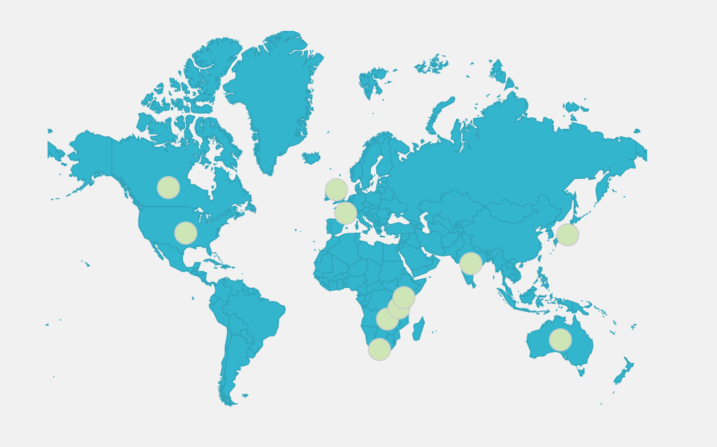
Worldwide Movement
ACTION Partners
RESULTS International
results.org/where-we-are/

Slide 10
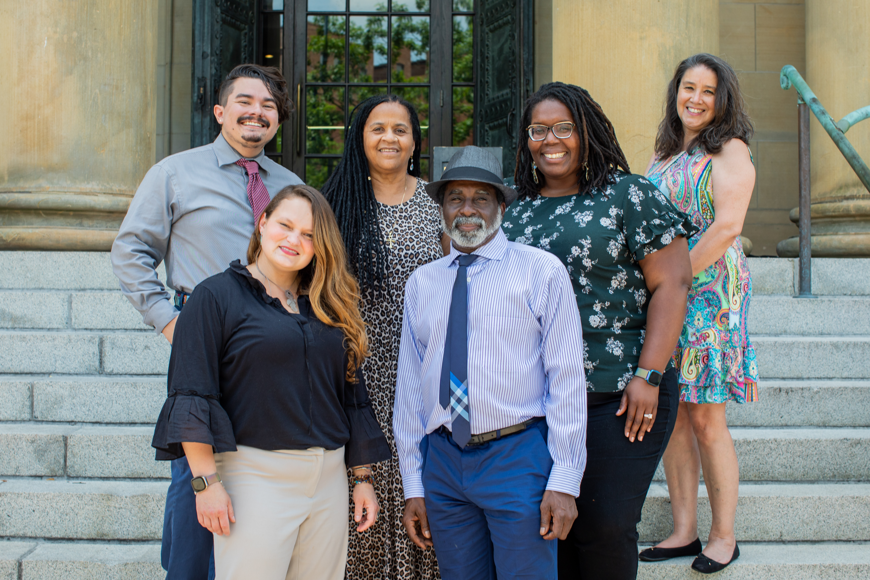
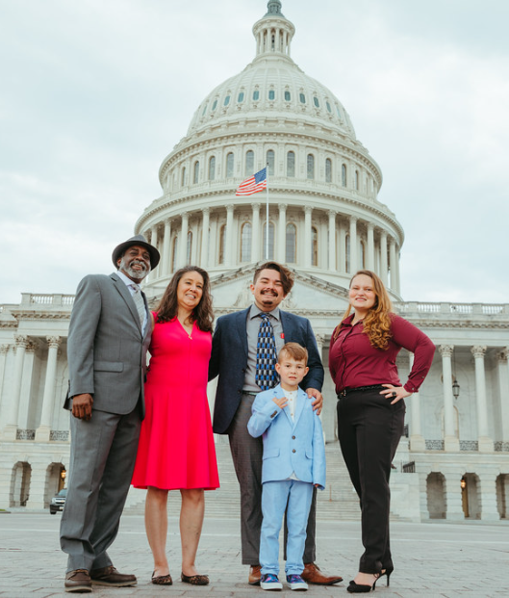
Experts on Poverty
results.org/experts-on-poverty

Slide 11
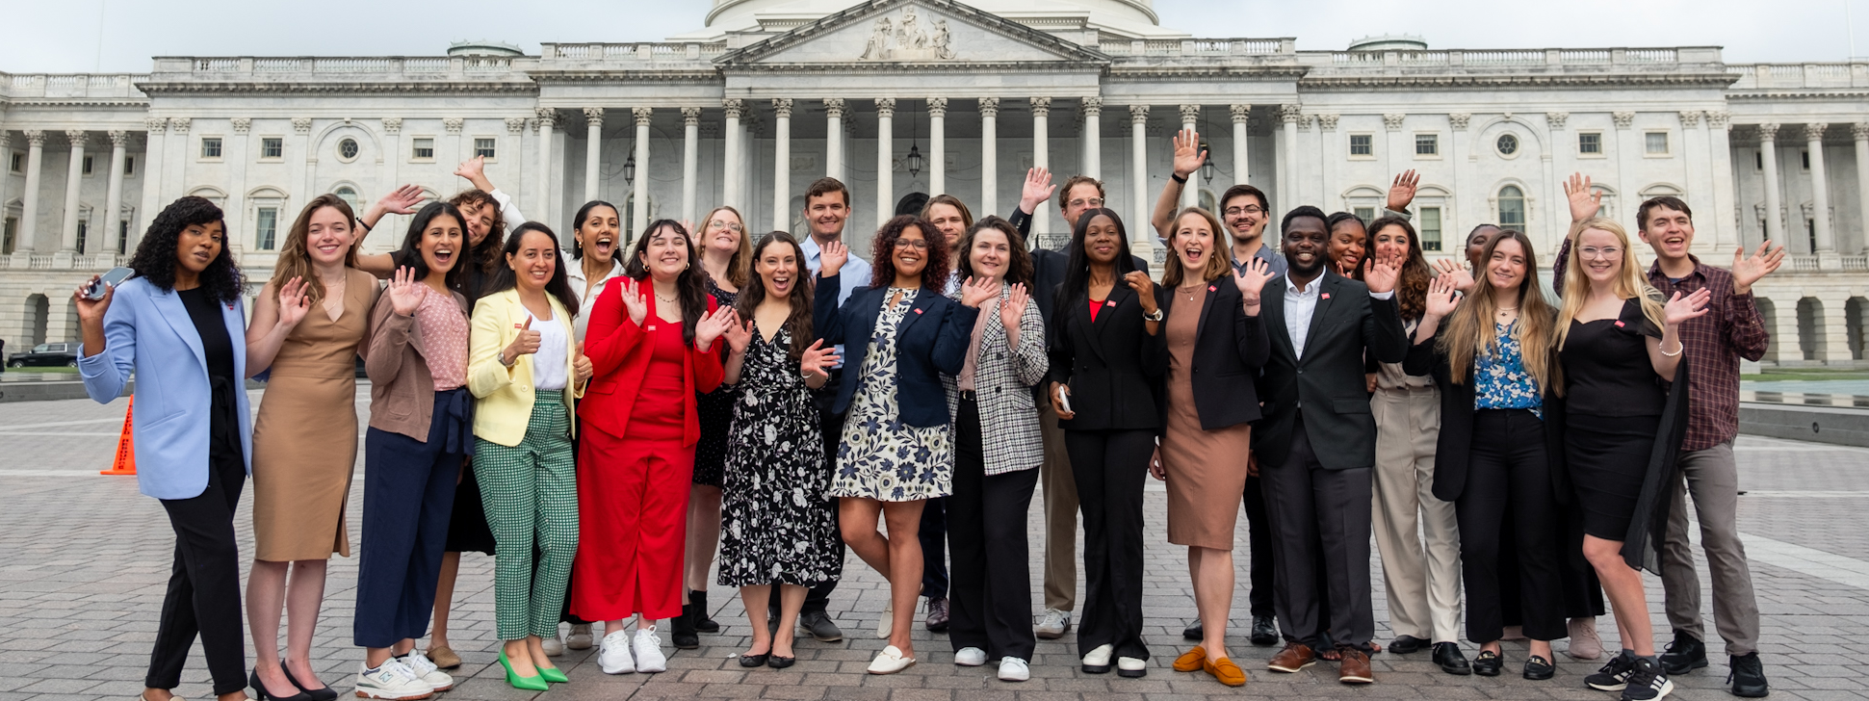
RESULTS Fellows
results.org/fellowship

Slide 12
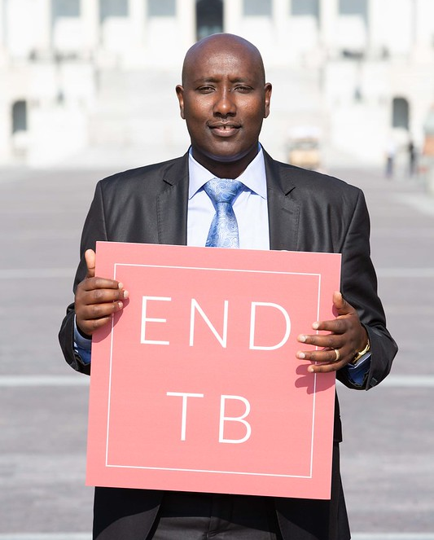
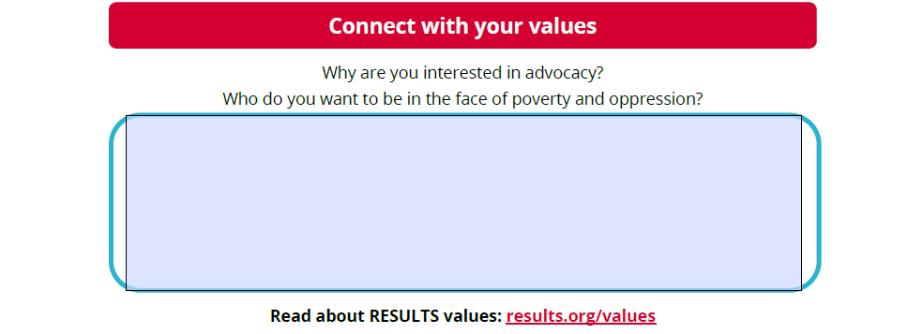
What’s your “why”?
Write your answers in the Advocacy Action Plan!

Slide 13
Advocacy Strategy

Slide 14
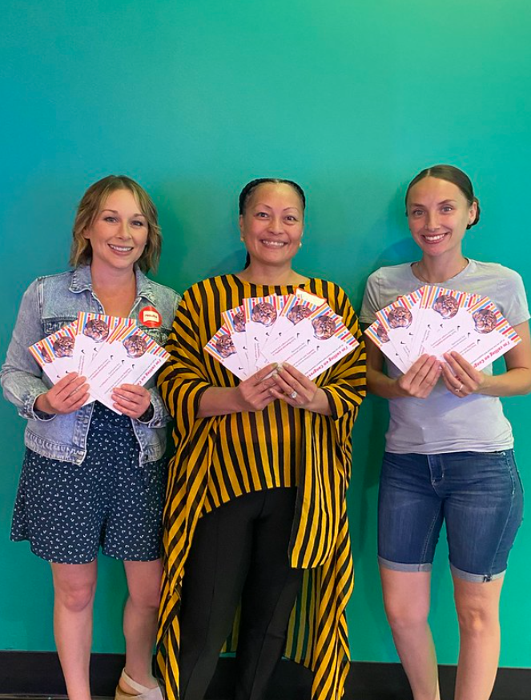
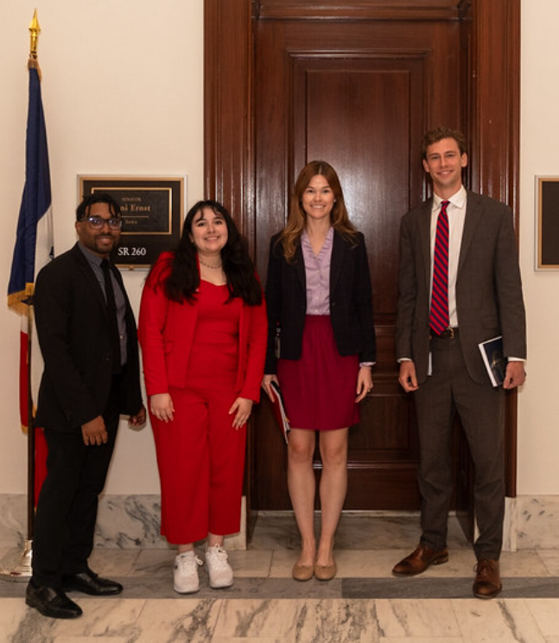
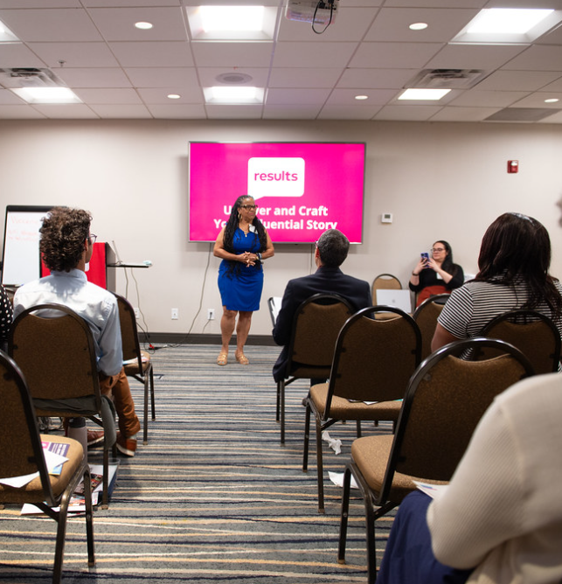
RESULTS Advocacy

Slide 15
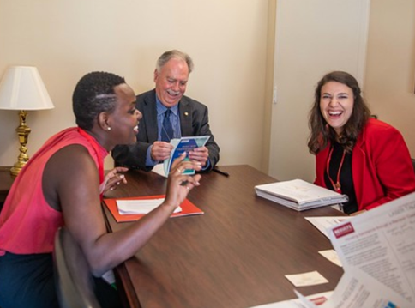
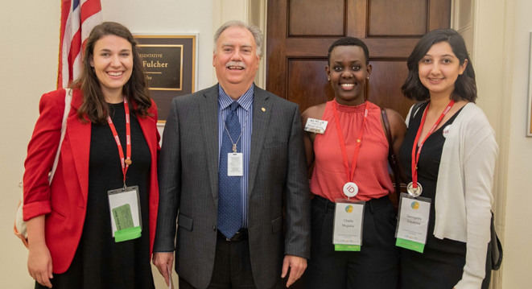
Influence
Trust
Relationships

Slide 16
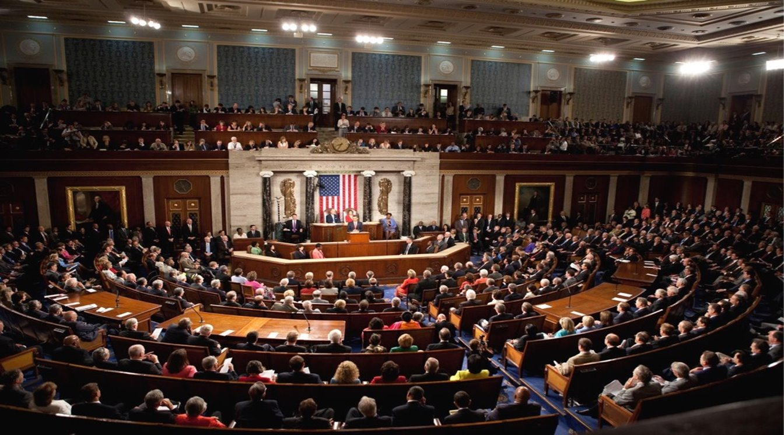
Why Congress?
  The government makes decisions about EVERYTHING
  Taxes Investments Voting Services
Yet, many people don’t know who represents them in Congress. Many will never contact their member of Congress or hold them accountable to their decisions.

Slide 17
Advocacy Skill

Slide 18
Do you know your members of Congress? (MoC)

Slide 19
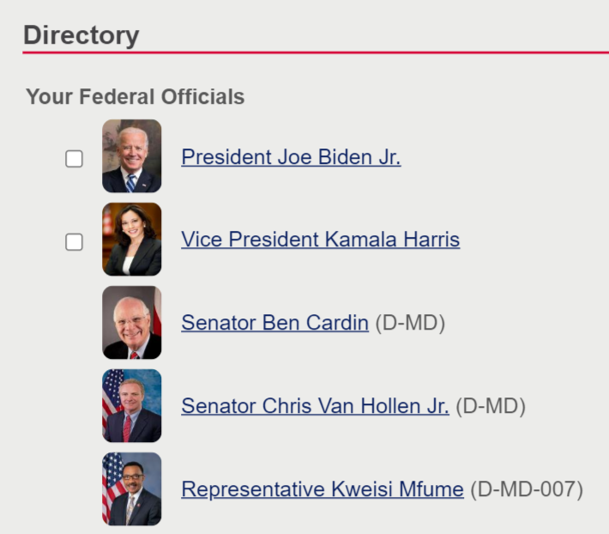
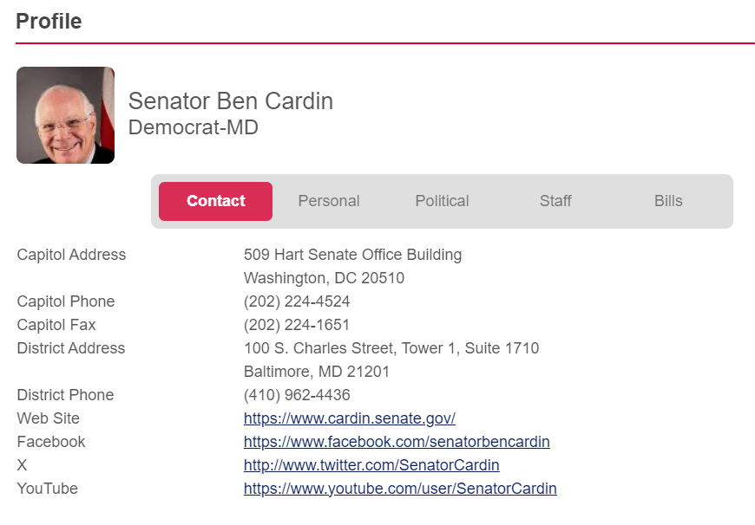
Legislator Lookup
www.results.org/legislator-lookup

Slide 20
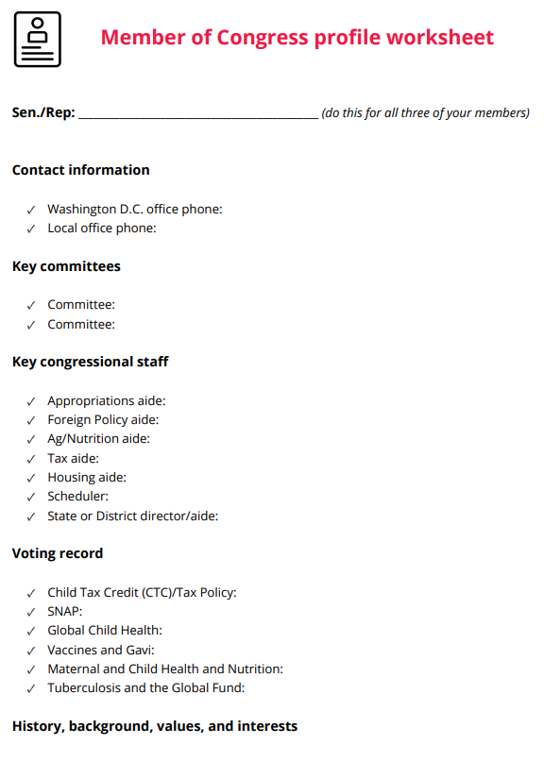
Advocacy Skill:
Research your MoC
Key committees
Congressional staff
Voting Record
Background info
Download the New Advocate Starter Pack

Slide 21
The Issues

Slide 22
Issue Areas
Economic Opportunity
& Security
Health & Nutrition
Education

Slide 23



Child Tax Credit, Earned Income Tax Credit
U.S. Campaigns​
Renter's Tax Credit
Supplemental Nutrition Assistance Program (SNAP)

Slide 24


Global Fund to Fight AIDS, TB and Malaria
Global Campaigns​
Gavi, the Vaccine Alliance
Appropriations

Slide 25
Make it personal
Why do you care about these issues?
How have these issues impacted you or your community?
Write your answers in the Action Plan!

Slide 26
Volunteering

Slide 27
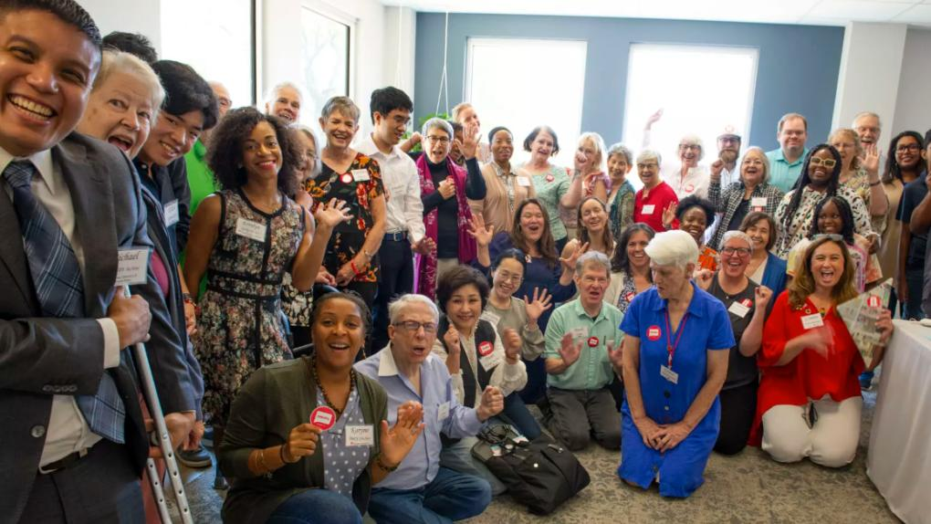
First 100 Days 2025

Slide 28
Join the RESULTS New Advocate Training & Action program
Staff led advocacy training & action meetings
Meet once a month via Zoom, 3rd week of the month
Learn new skills, take action together
  U.S. & Global Poverty Issue Education
  Contact your member of Congress
  Write a Letter to the Editor
  Community organizing 101

Slide 29
RESULTS Resources
MONTHLY Webinar
Volunteers Hub
New Advocate Starter Pack

Slide 30
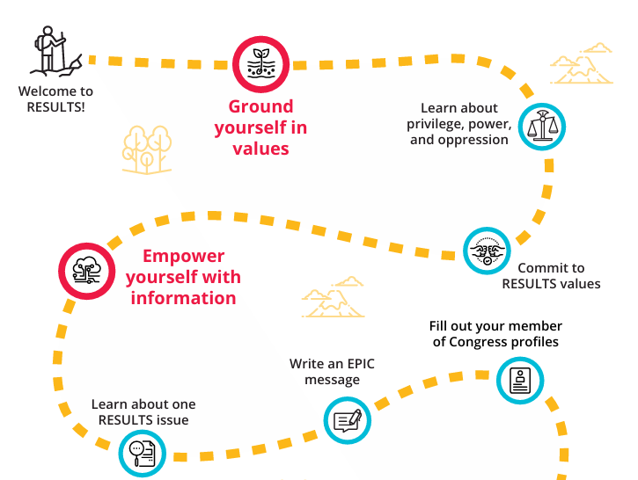
New Advocate Starter Pack
Start your advocacy journey with RESULTS

Slide 31
Join the movement

Slide 32
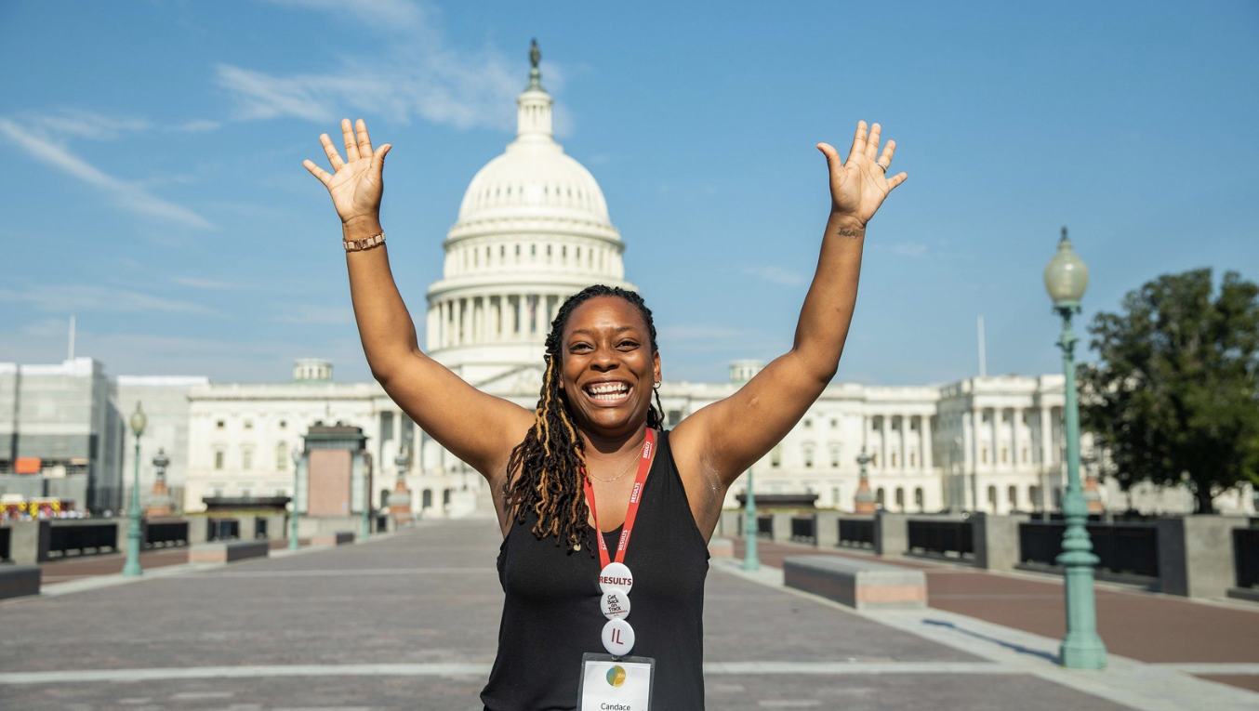

Be an advocate

Slide 33
Join RESULTS
Step 1
Schedule a 1:1 if you still have questions
Step 2
Step 3
You will receive a follow-up email with resources
Fill out the volunteer onboarding form to join
We will share next steps via email
Questions? Email us at volunteer@results.org
Get your New Advocate Starter Pack

Slide 34
"I am looking for community that shares my dream of how the world could be and I'm aligning with that, doing my best to create that dream."
-Jeff Bridges, on Jimmy Kimmel Live

